Slide 1


Slide 2
What is CloudHour?
Objective of CloudHour
Round-table discussion
Focus on a few key topics
Why It's Important
Rapid changes in cloud security and tech
Stay updated and connected for growth as community
How it will benefit the community
Real-time engagement with hosts and community members
Ask open questions and speak your opinion
Opportunity to affect the next agenda
Notes:
Objective of CloudHour
The objective of CloudHour is to create a collaborative space where professionals can come together to discuss, learn, and share insights on the most pressing topics in cloud security and modern workplace technology.
Why its important
CloudHour is important because, in the rapidly evolving landscape of cloud security and workplace technologies, staying updated and connected is crucial for career growth and organizational resilience
How it will benefit the community
By attending CloudHour, community members will have the unique opportunity to engage with industry experts in real-time, ask questions, network with like-minded professionals, and even have the chance to contribute their own expertise by becoming guest speakers in future episodes.

Slide 3

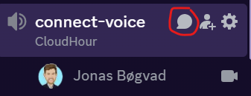
If you prefer to not talk or be asked questions press mute
press mute just mute the mic
If you preferer to chat press

Slide 4
Welcome & Agenda
MS EMS Teams event recap
Windows 11, version 24H2 security baseline
Device Inventory / Device Query
Device Attestation
Purview MS Approach

Slide 5
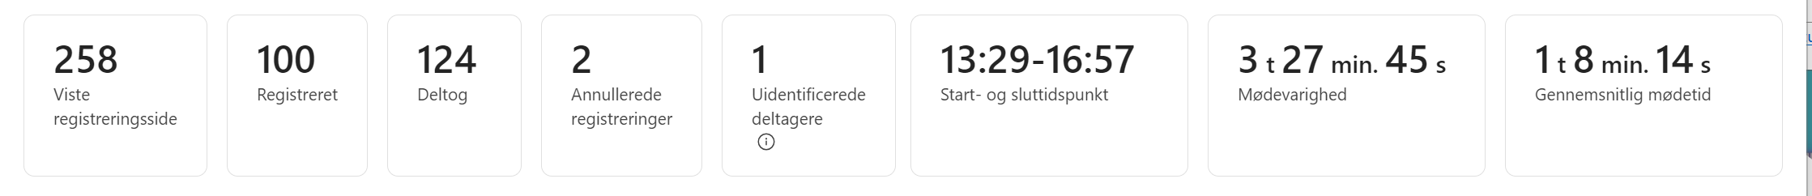
MS EMS Teams event
https://www.youtube.com/watch?v=hc11q4404H0

